Slide 1
UnBook
Lavousier Ferreira
Luiz Felipe
Ana Carolina
Denys Abner
Klark Gable

Slide 2
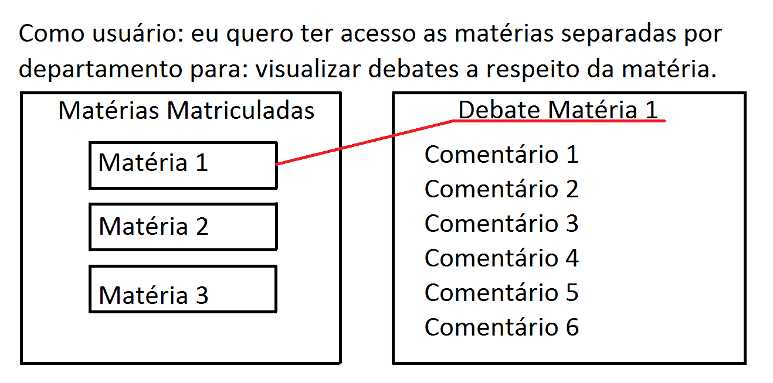

Slide 3
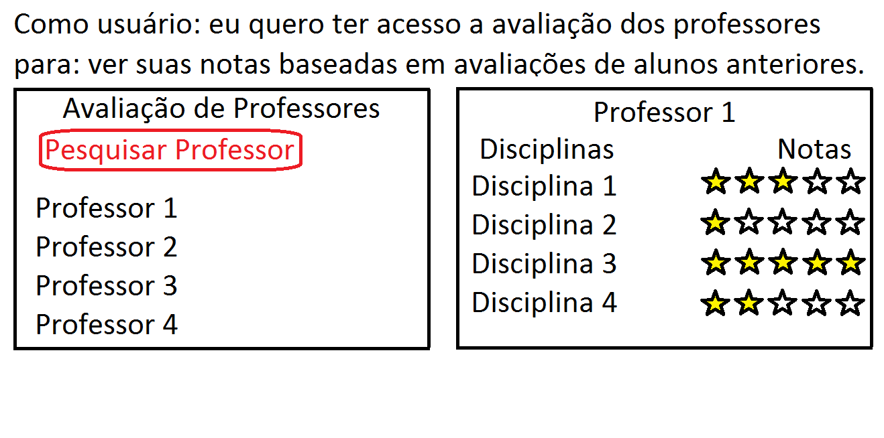

Slide 4
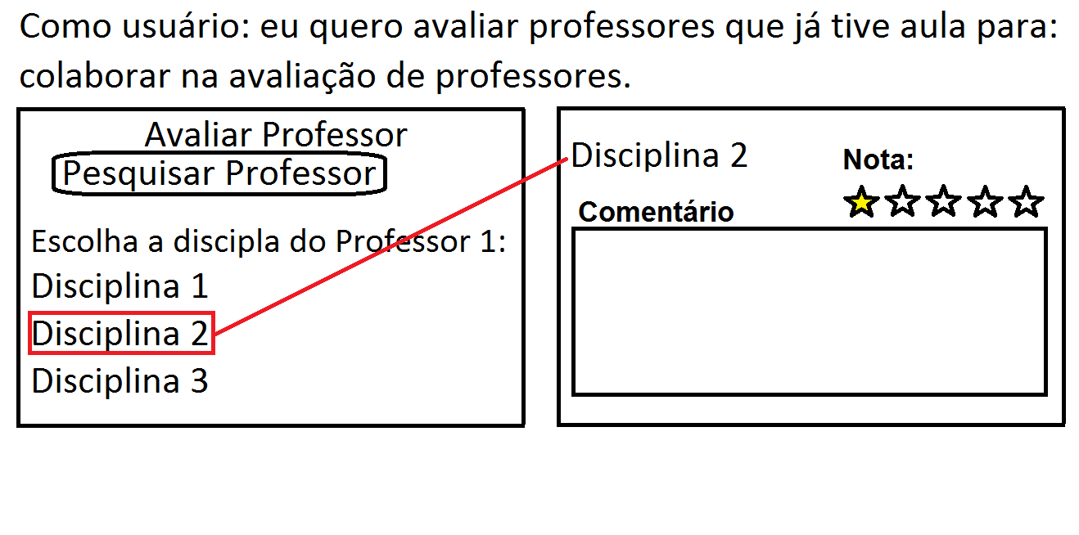

Slide 5
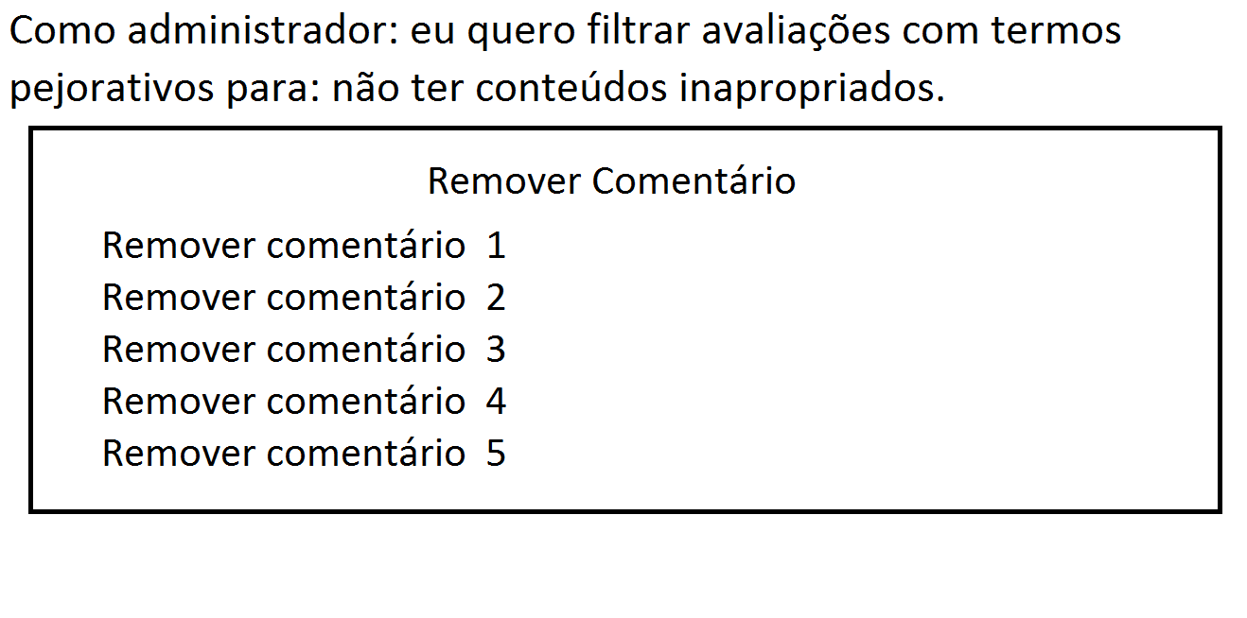

Slide 7
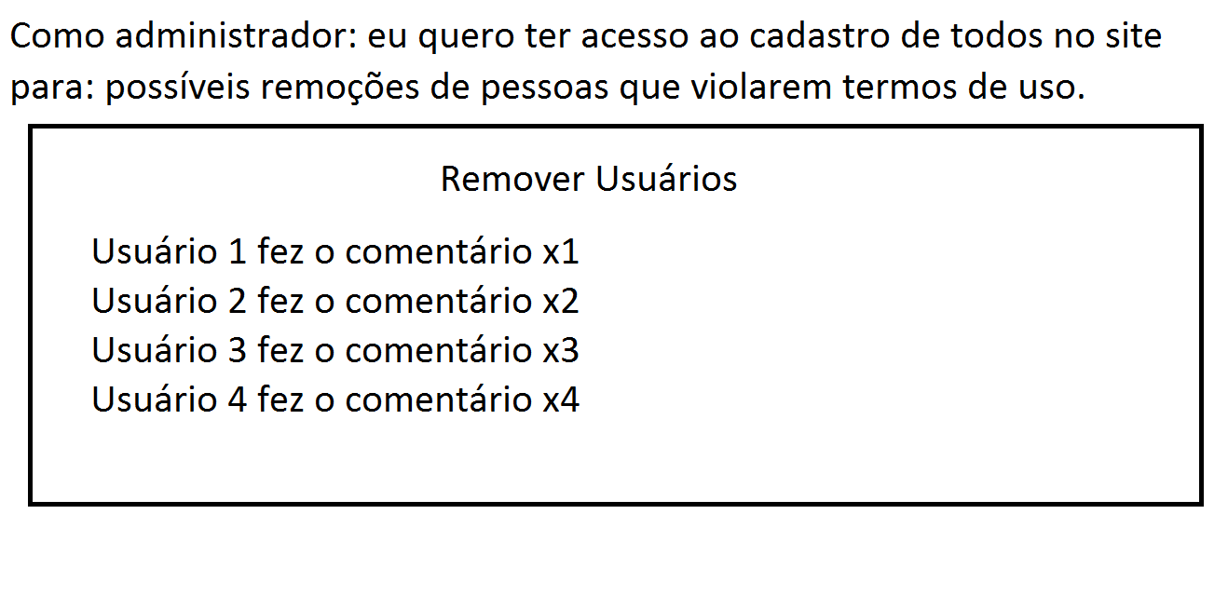

Slide 8
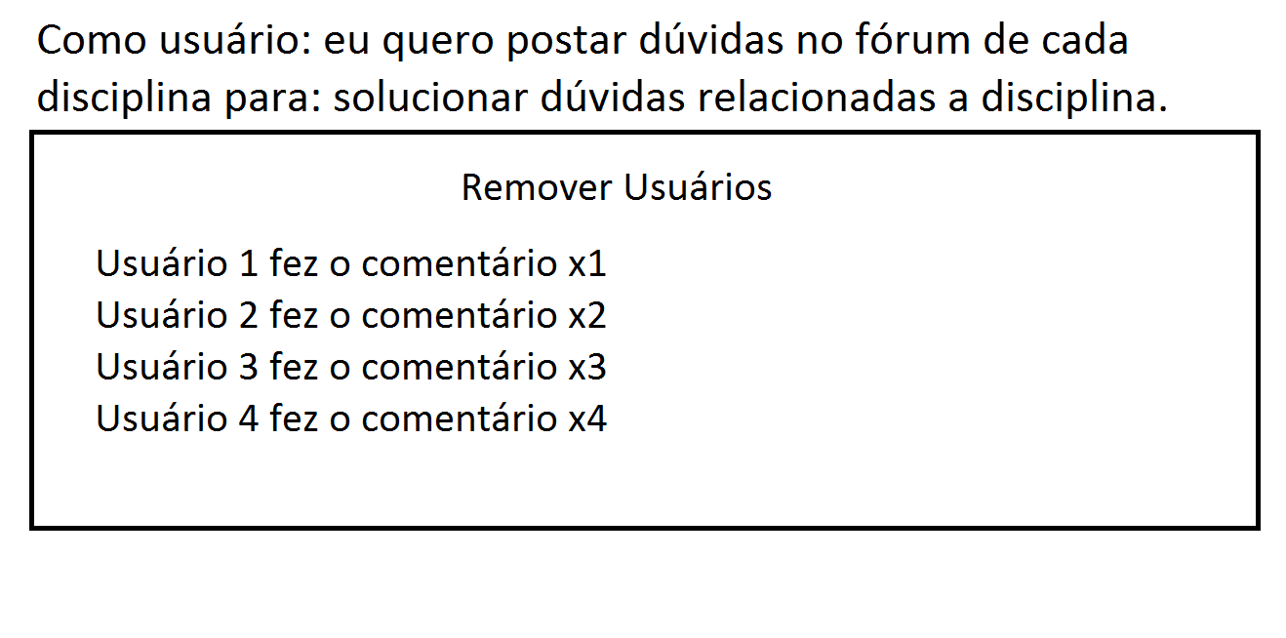

Slide 9
